Slide 1
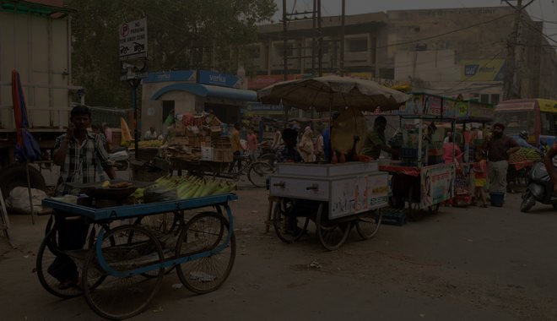

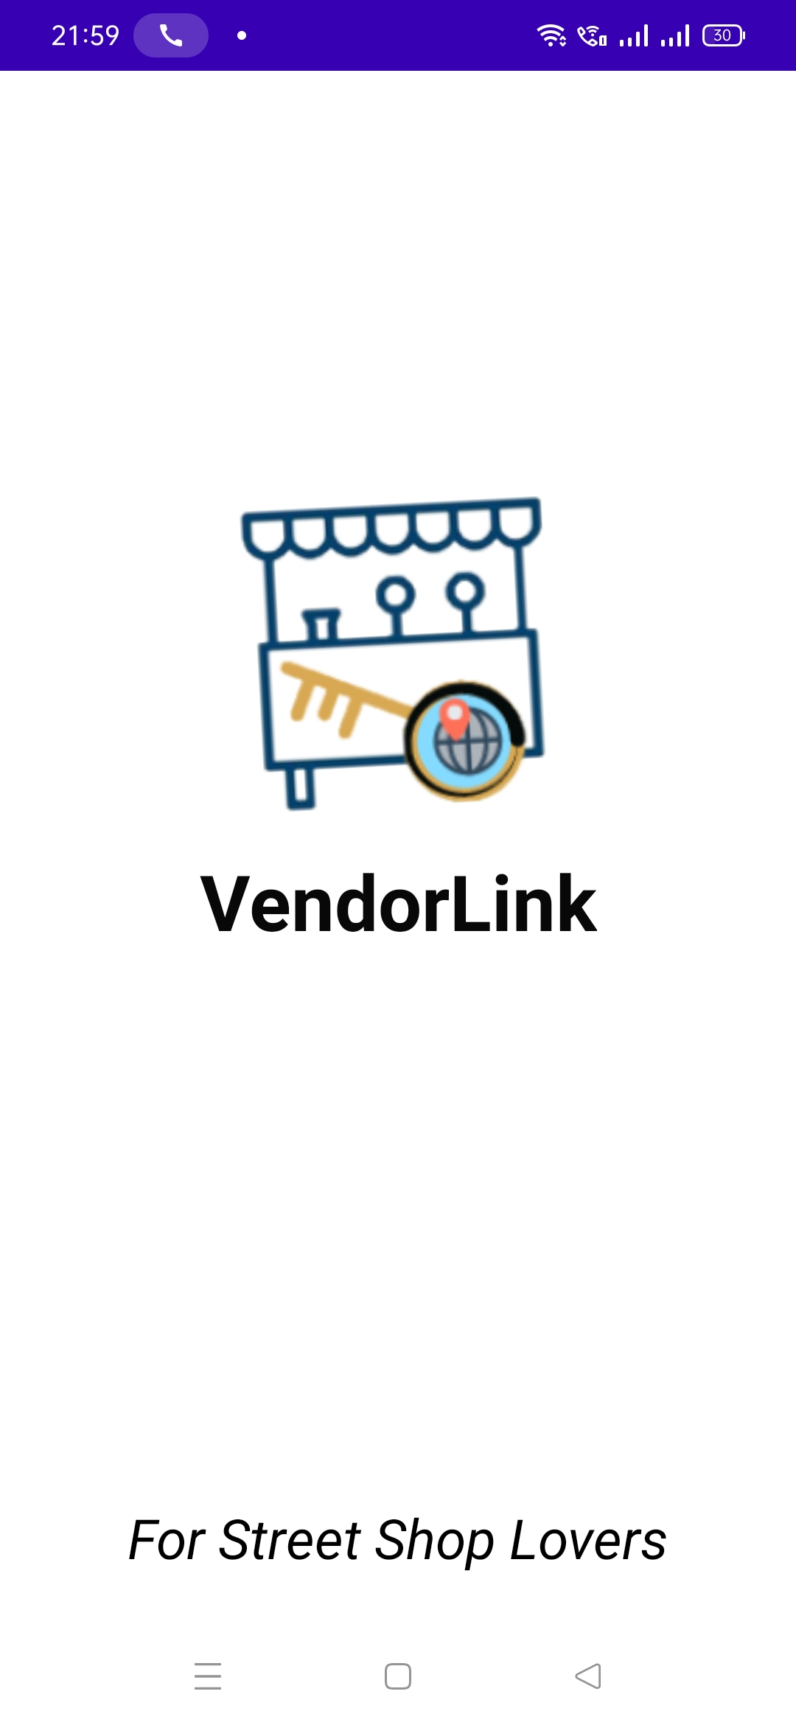
VendorLink Connecting Customers to Street Vendors

Slide 2



GROUP MEMBERS
GROUP NO. 2
19410 – Hatim Mullajiwala
19403 – Habban Bhoira
19409 – Glen Dsouza

Slide 3

INTRODUCTION TO VENDORLINK

Slide 4





Problem Statement
WHY IS THIS APPLICATION IMPORTANT

Slide 5
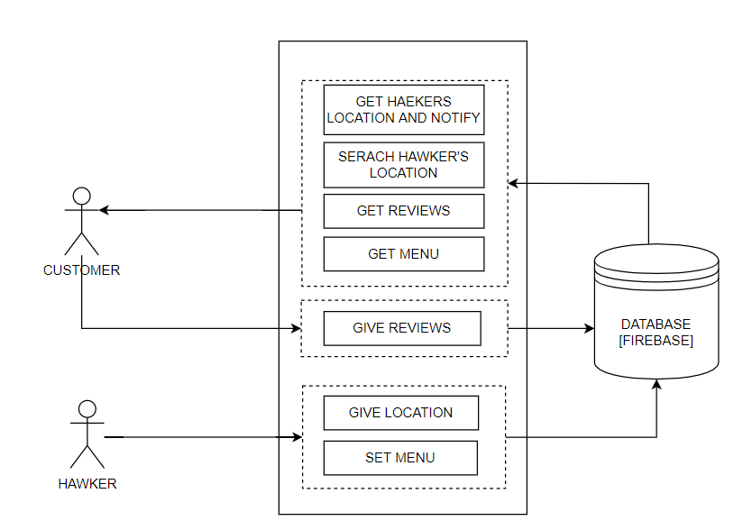
BLOCK DIAGRAM

Slide 6
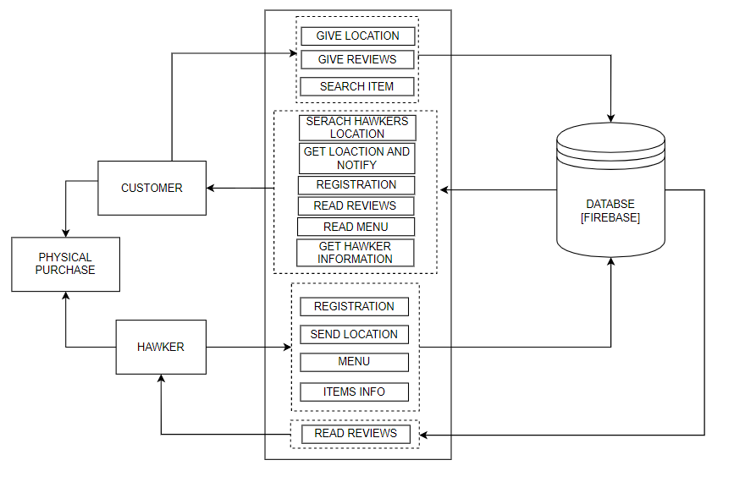
SYSTEM ARCHITECTURE

Slide 7







WORKING & FEATURES OF THE APPLICATION

Slide 8

ADVANTAGES
Quick access through app
Expand the reach of vendor/hawker
Being Hyperlocal will save time of customer
Customer can check credibility of hawker/vendor through reviews & ratings.
Vendor has access to feedbacks from customer
Customer will be notified on arrival of vendor in customer’s vicinity
The customer can access vendor/hawkers contact information
Customer can physically visit vendor and examine the product before buying

Slide 9

LIMITATION & DIS-ADVANTAGES
Necessarily requires a smartphone.
Application not supported on IOS mobile OS.
Non-English speaking user might face problems while using the application as the content and reviews would be available only in English.
For live Tracking, constant access to internet & GPS connectivity is required.

Slide 10

FUTURE SCOPE
Multi-OS & Multi-lingual Support
Implement social platform to share images of experiences with friends and followers.
Feature to direct message vendors via the application.
Enable wallet and feature to pay via UPI interfaces.
Feature to track customer demand in areas via maps.

Slide 11


